Slide 1

TEAM TWO - ProManager
Iteration 3 Github Link: https://github.com/BUMETCS673/project-microserviceteamtwo

Slide 2
Team Members | Roles
Praveen Singh | Team Lead
Pranjal Ekhande | Requirement Lead
Dipayan Mazumder | Security Lead
Aman Jain | Configuration Lead , QA Lead
Mukul Jangid | Design and Implementation Lead

Slide 3
INTRODUCTION - ProManage
ProManage project management platform to streamline project creation, editing, collaboration management, and feedback processes.
Offers project-based learning for students and professionals.
The platform will provide an environment where users can create and manage projects, access, collaborate with team members, create tasks, assign task and feedback on their work.
Users will be able to optimize resources, mitigate risks and deliver projects on time.

Slide 4
Project Planning
Iteration | Functional Requirements(Essential/Disable/Option) | Tasks (Cross requirements tasks) | Estimated/real person hours
1 | Iteration 0 | Environment Setup, Documentation, Initialisation | 50 - 60
2 | Iteration 1 Code Skeleton Project Creation | Design, Implementation, Testing | 150 - 160
3 | Iteration 2 Added Task and Comment features Automated Testing Code coverage report | Design, Implementation, Testing | 200-220
4 | Integration 3 Code deployment Database deployment Test cases | Deployment, Implementation, Testing | 150-160

Slide 5
Deliverables
Project Management
Creating New Project and assigning ownership while doing it. Baseline Delete and safe Delete Project to avoid data loss.
REST calls for modifying project details, timelines, and tasks.
Tasks for Each Project:
Assigning Tasks in a Project for the members.
Individual Tasks are present for each of the Project.
Comment Management:
To enable feedback on task and project.
Fixing Comment to reduce typos
User Collaboration for Each Project:
Adding access to user in Project. Assigning Roles to To Project.
Getting Projects and Tasks Related to particular User

Slide 6
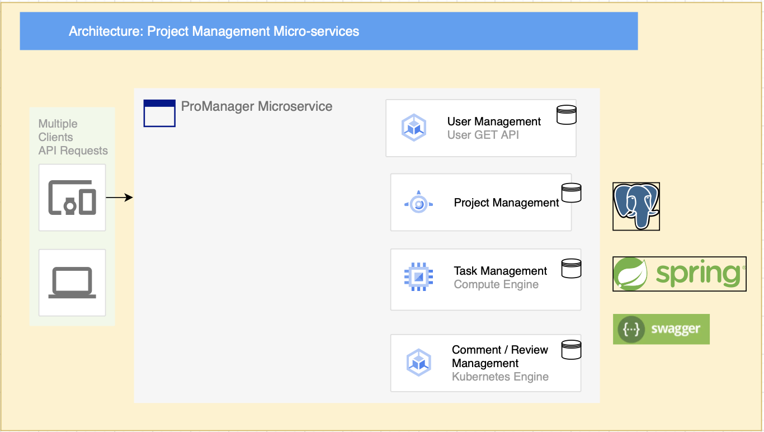
Architectural Diagram

Slide 7
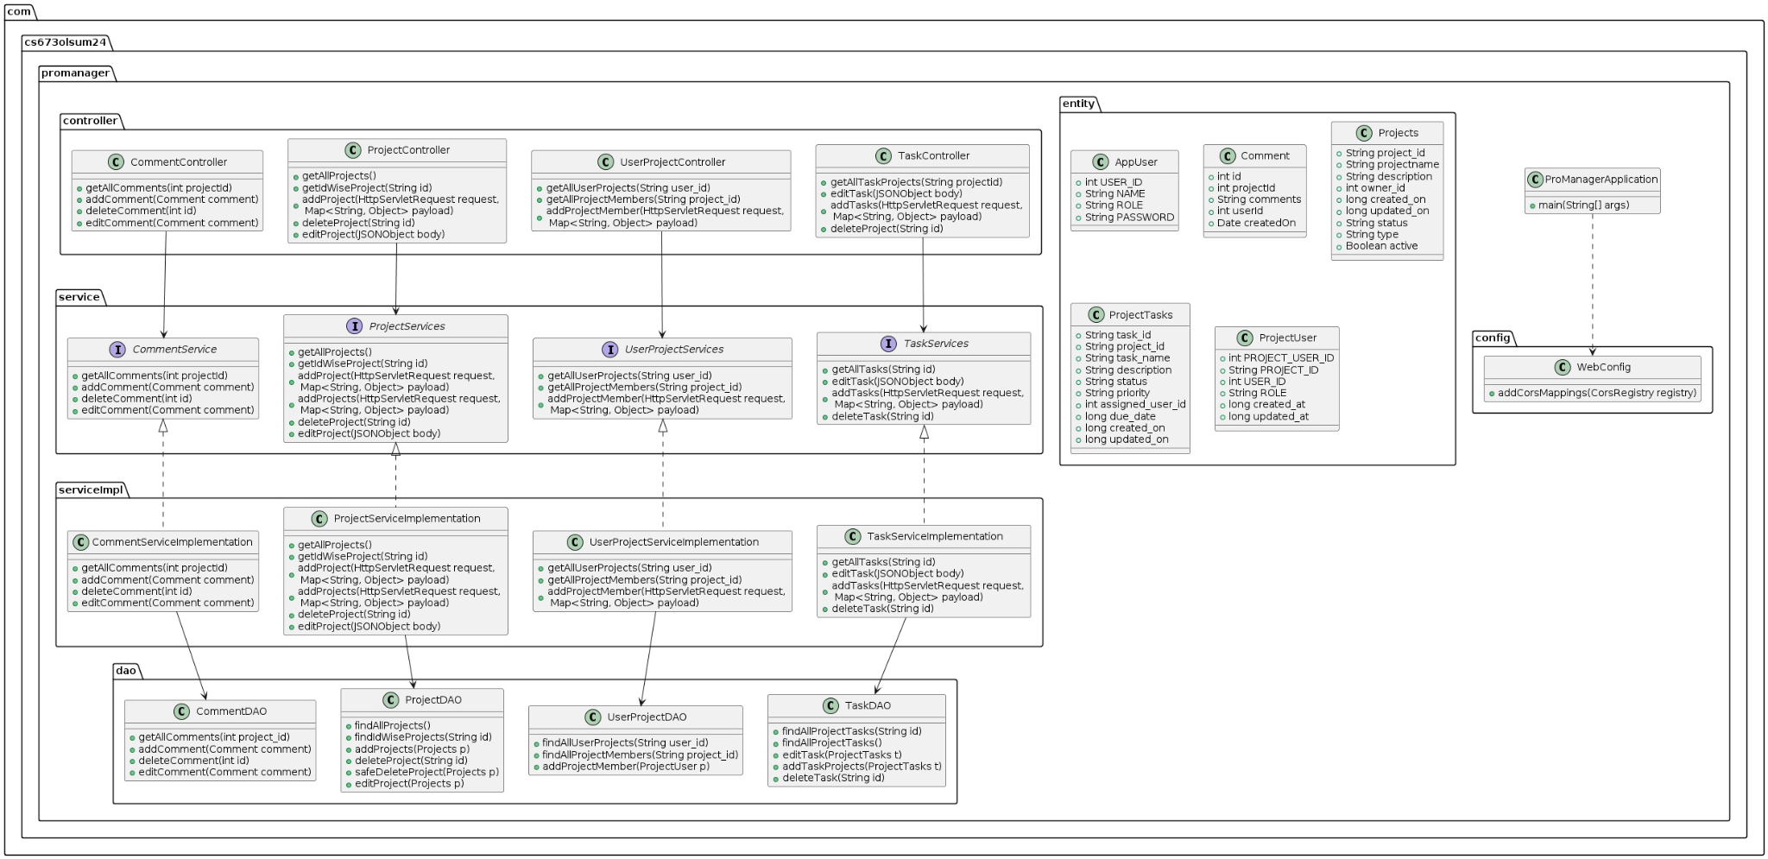
Class Diagram

Slide 8
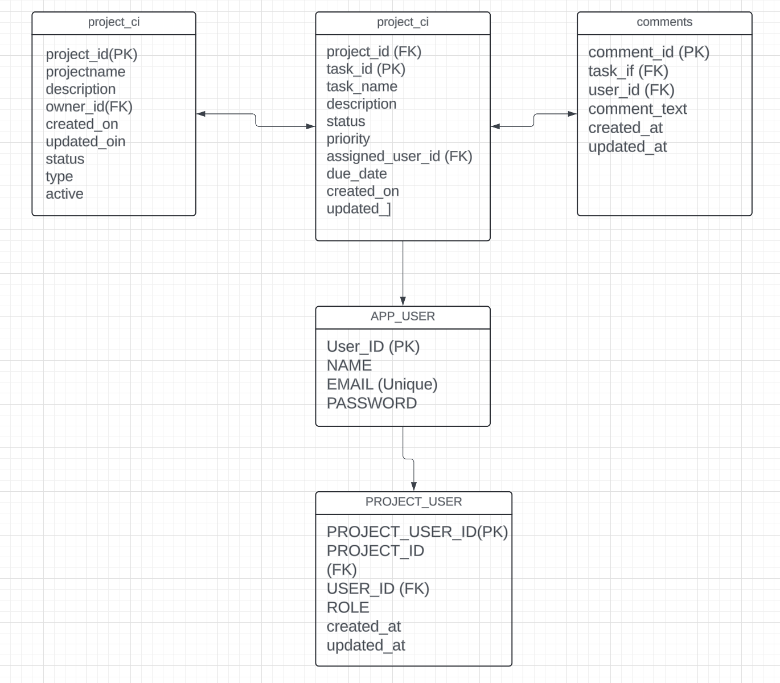
Database Diagram

Slide 9
CONFIGURATION TOOLS
Version Control: Git and GitHub
IDE: IntelliJ / Spring Tool Suite
Code Editor: VSCode, IntelliJ, DataGrip
Dependency Management: Maven
Deployment: Heroku

Slide 10
Code Review Process
For Development branch the following processes will be followed:
Development branch -> Dev Testing -> PR raise -> peer review -> Testing -> Dev (preprod) -> Prod -> Ticket close
Peer Review would be mainly done by Mukul and Pranjal.

Slide 11
TESTING & QA
Our team adheres to the Google Java Coding Standards for writing Java code and Black code style for writing Python code.
Manual Testing: - Exploratory Testing - Regression Testing
Automated Testing: - Unit Testing (JUnit) - Integration Testing (JUnit, Mockito) - Code Coverage (JaCoCo)
We use Postman for API testing.

Slide 12
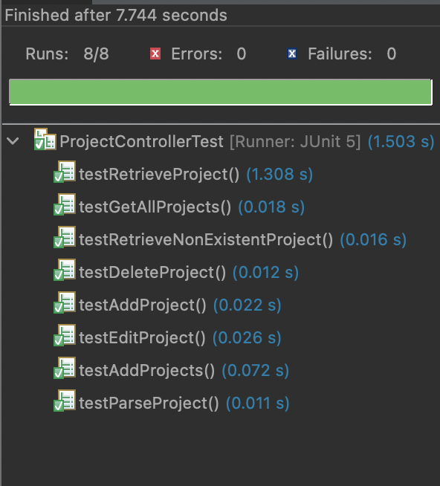


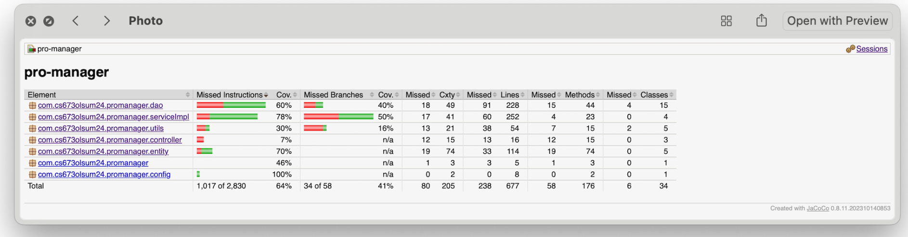
Testing - ProManager

Slide 13
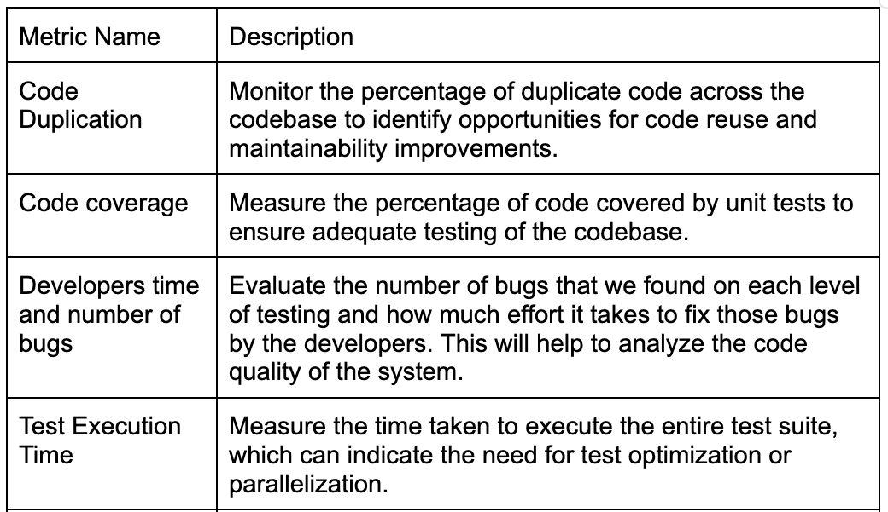
QA Matrix

Slide 14
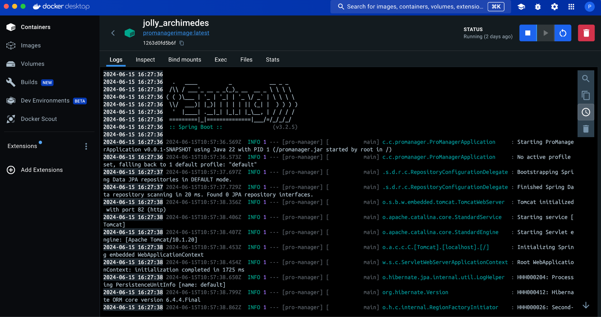
DOCKER CONTAINER

Slide 15
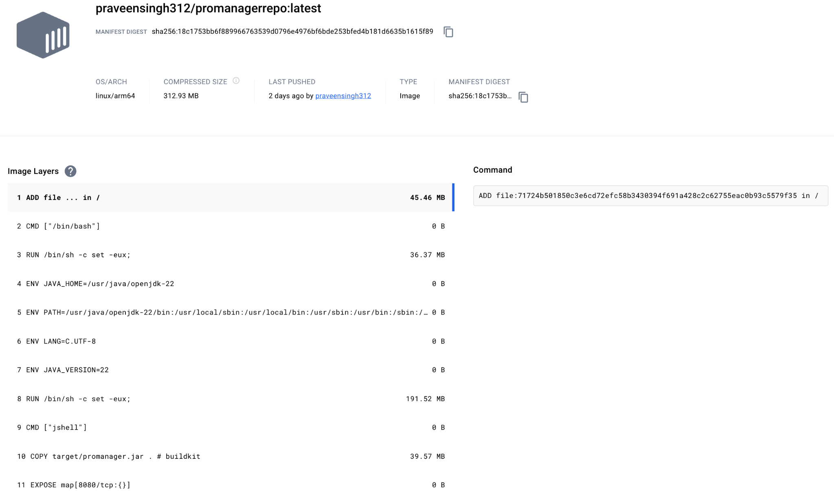
DOCKER IMAGE

Slide 16
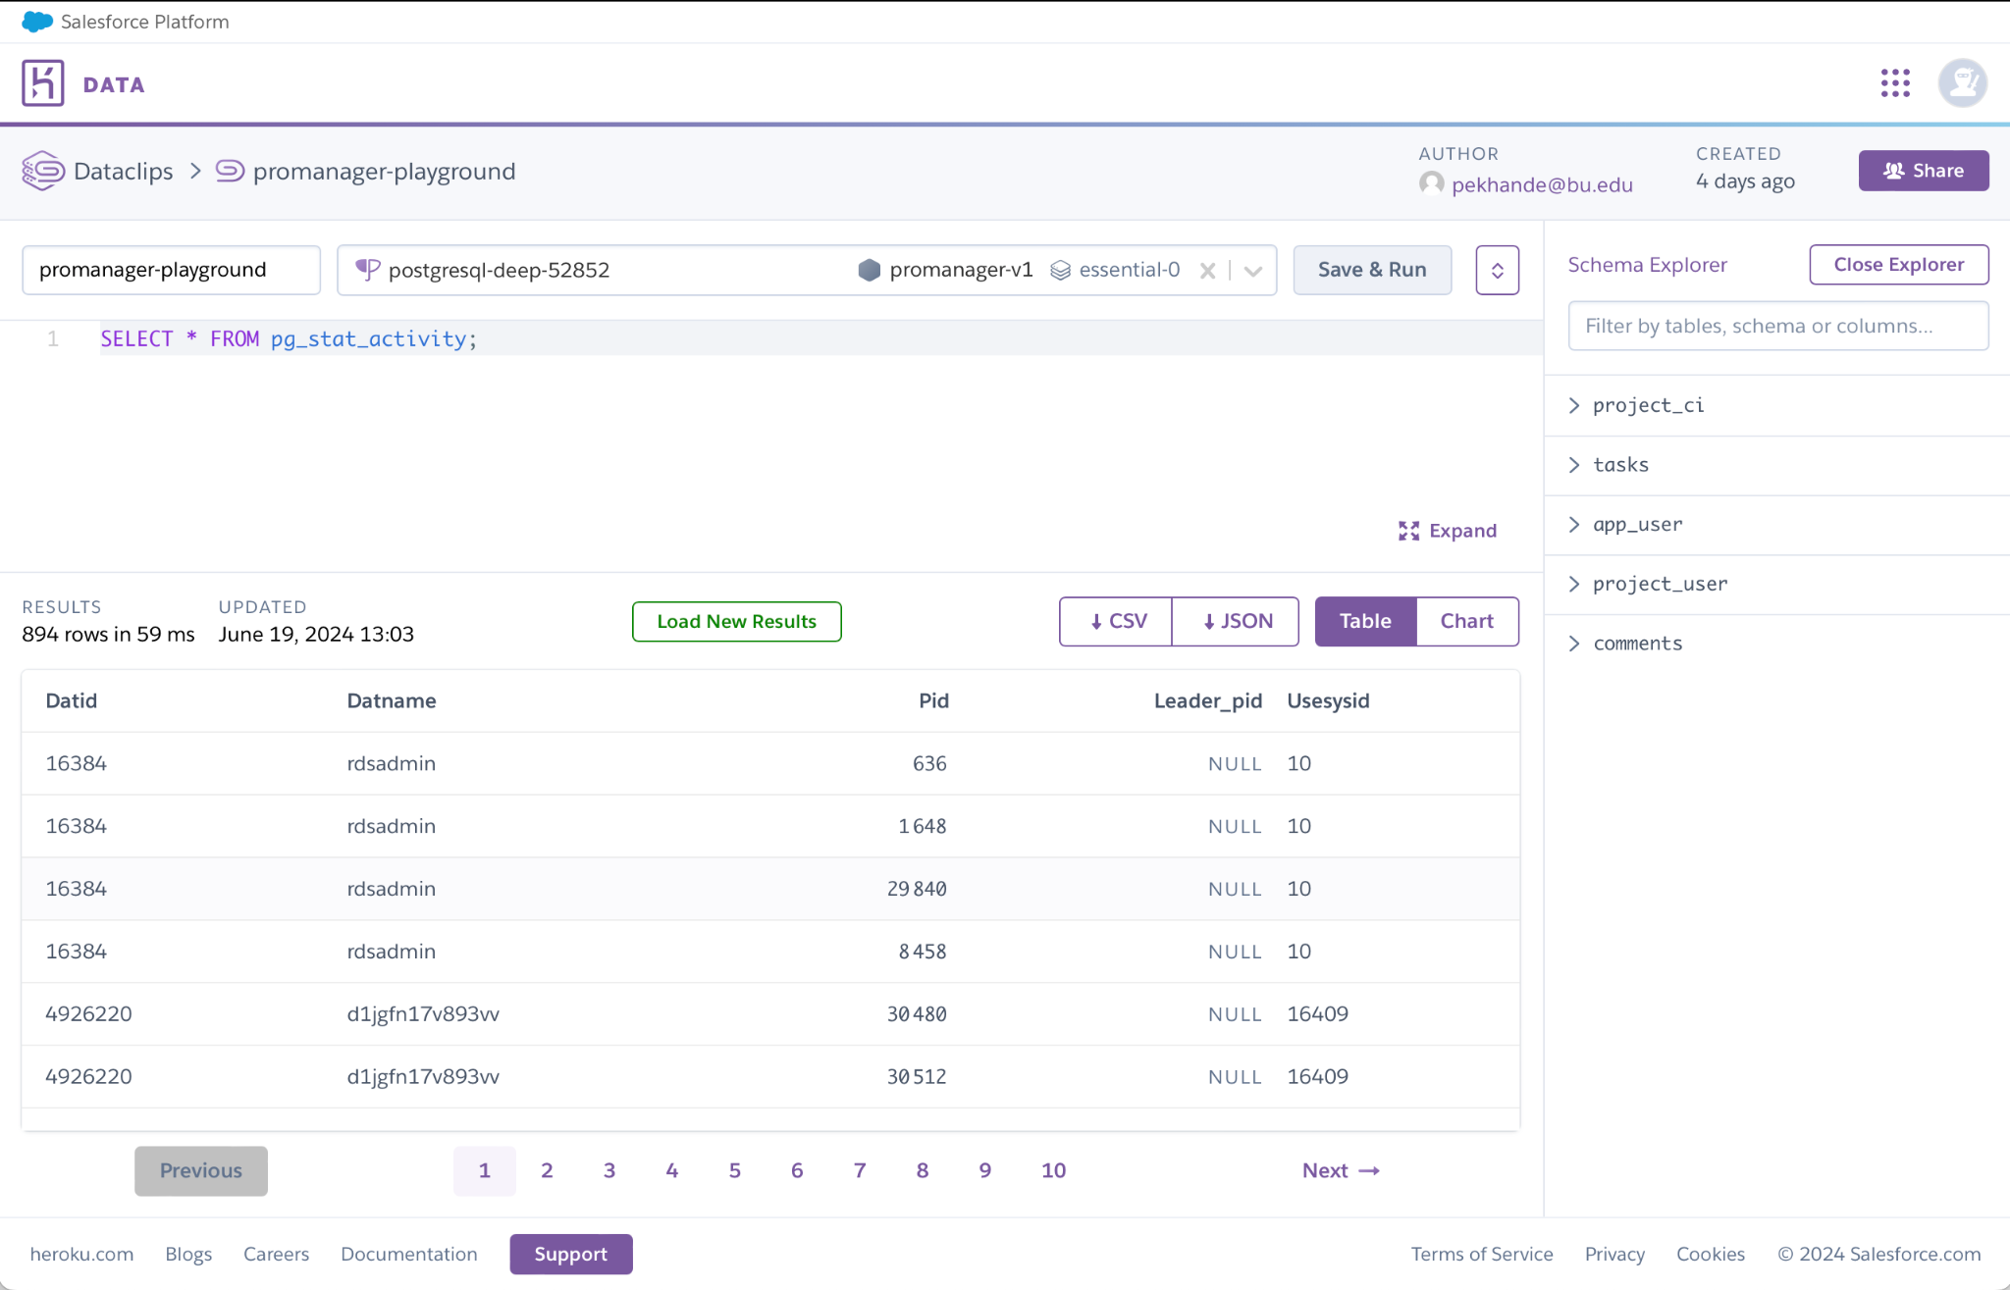
DataBase Deployment

Slide 17
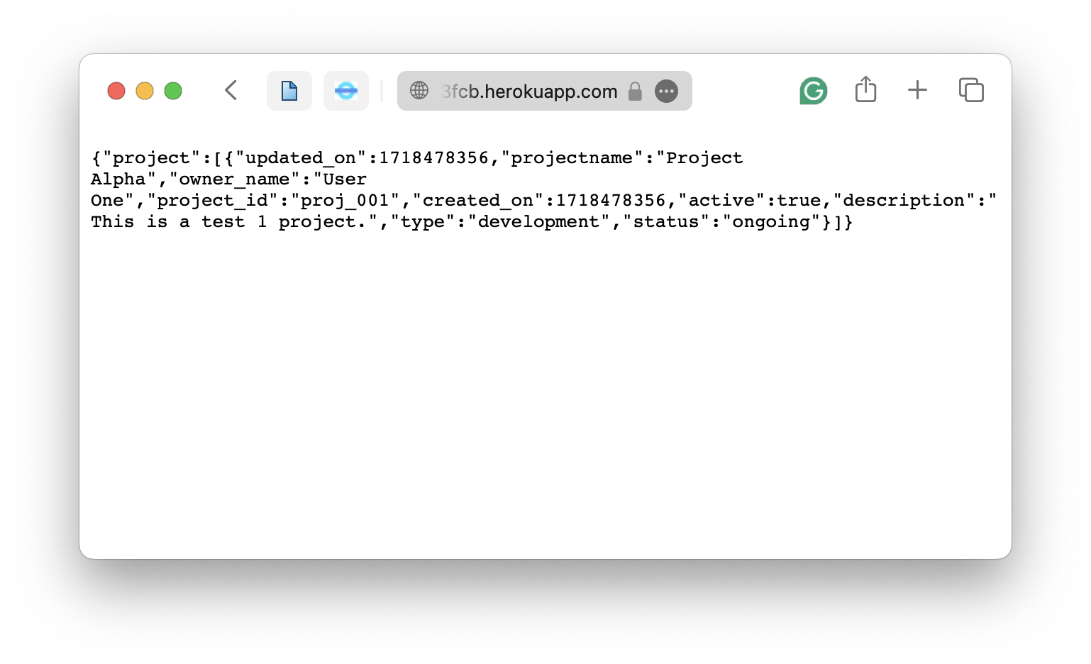
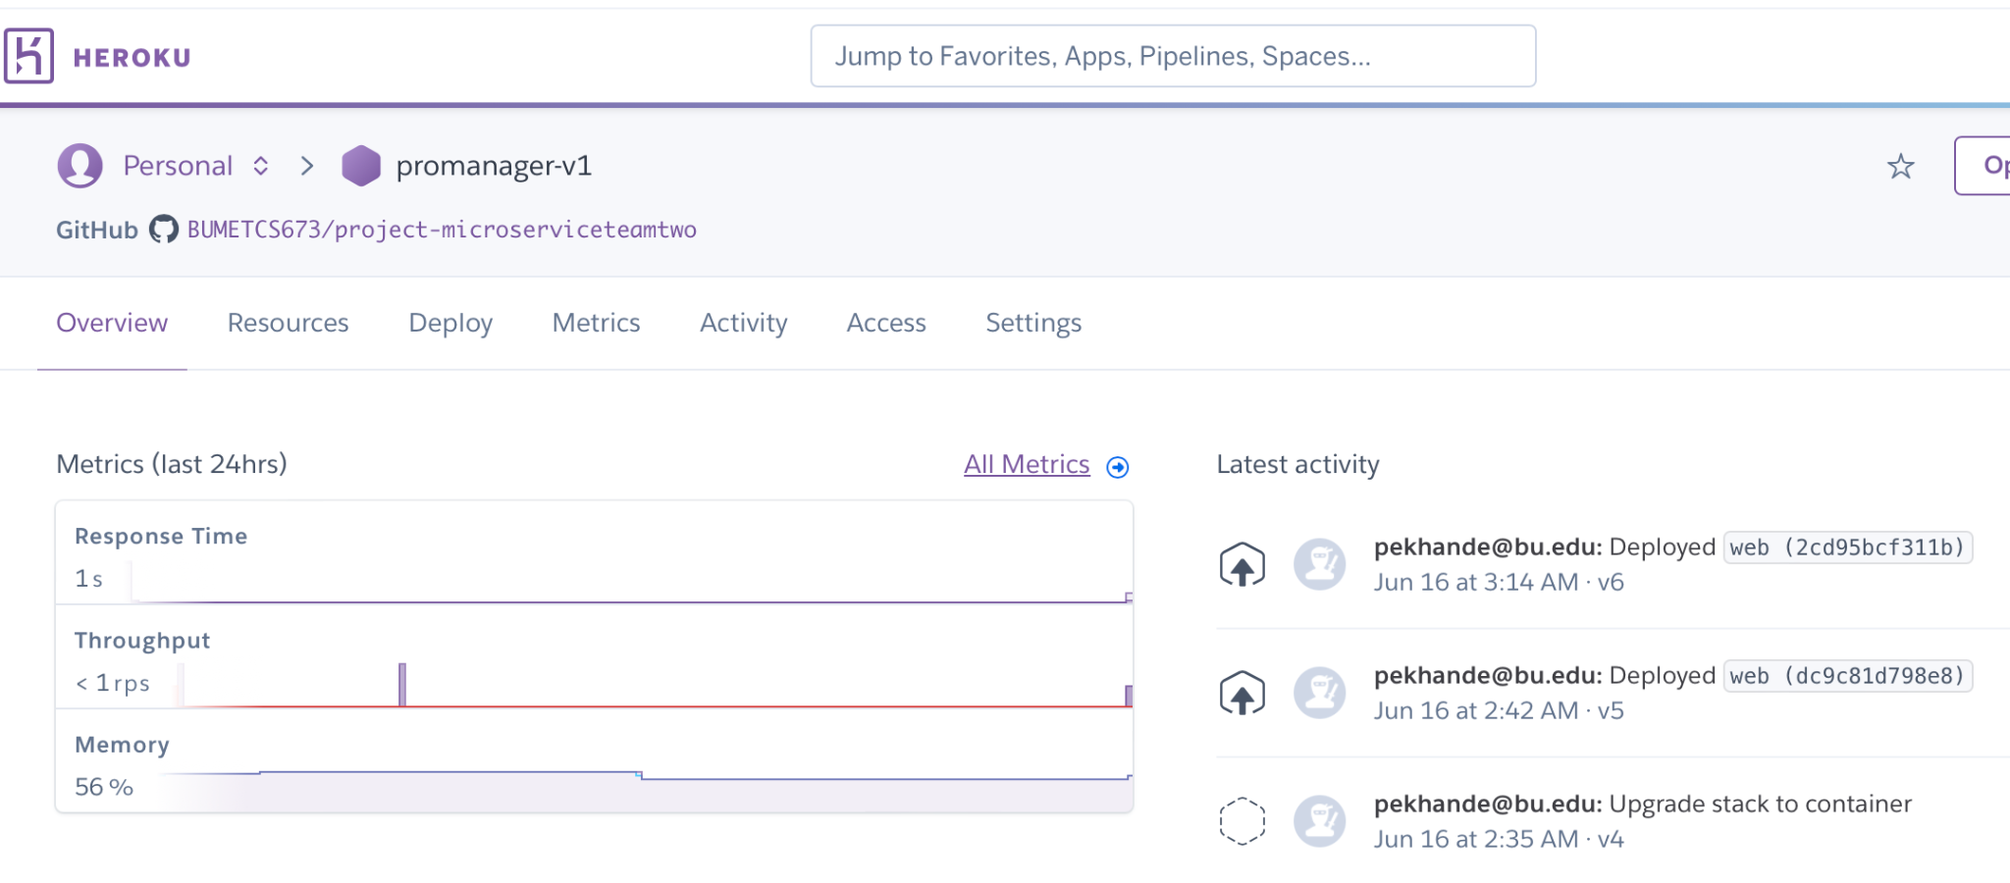
Application Deployment

Slide 18
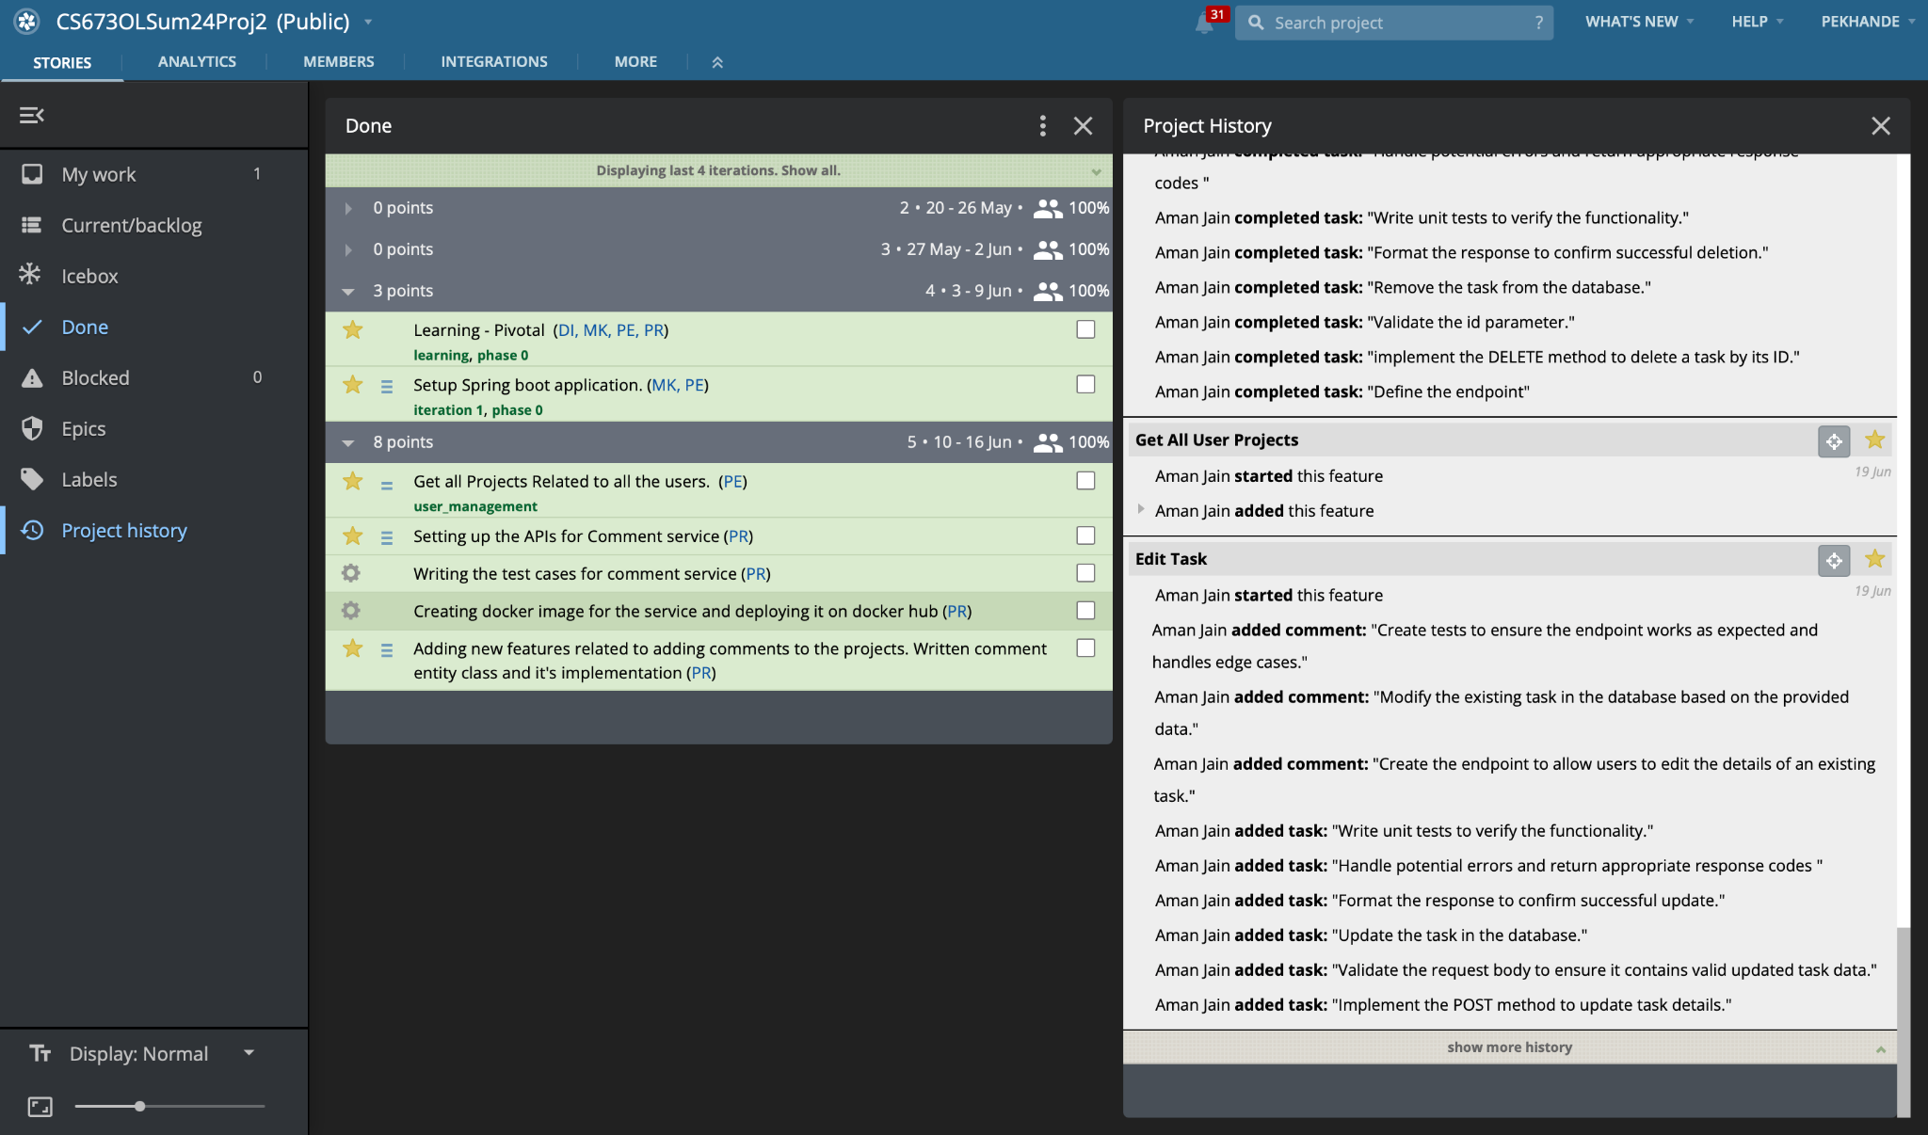
Achievement

Slide 19
Challenges
Fostering collaboration and maintaining team morale in a remote working environment required innovative approaches.
Some team members had limited coding experience, necessitating additional training and support.
Coordination across different time zones caused delays in communication and decision-making.
Integrating various components and third-party services into a cohesive platform presented technical difficulties.
Keeping the project on track despite unforeseen delays and obstacles required effective time management strategies.
The learning curve for adopting new technologies and programming languages impacted the development timeline.

Slide 20
Security
Our Team Implemented a peer review process
In the peer review process at least one team member has to review the code
But we always made sure that two members of the team went through the code for better QA and proofreading
We implemented main branch protection in GitHub
Any merges to main would have to go through the other team members to maintain the integrity.

Slide 21
THANK YOU

